Slide 1
Merchant Role

Slide 2
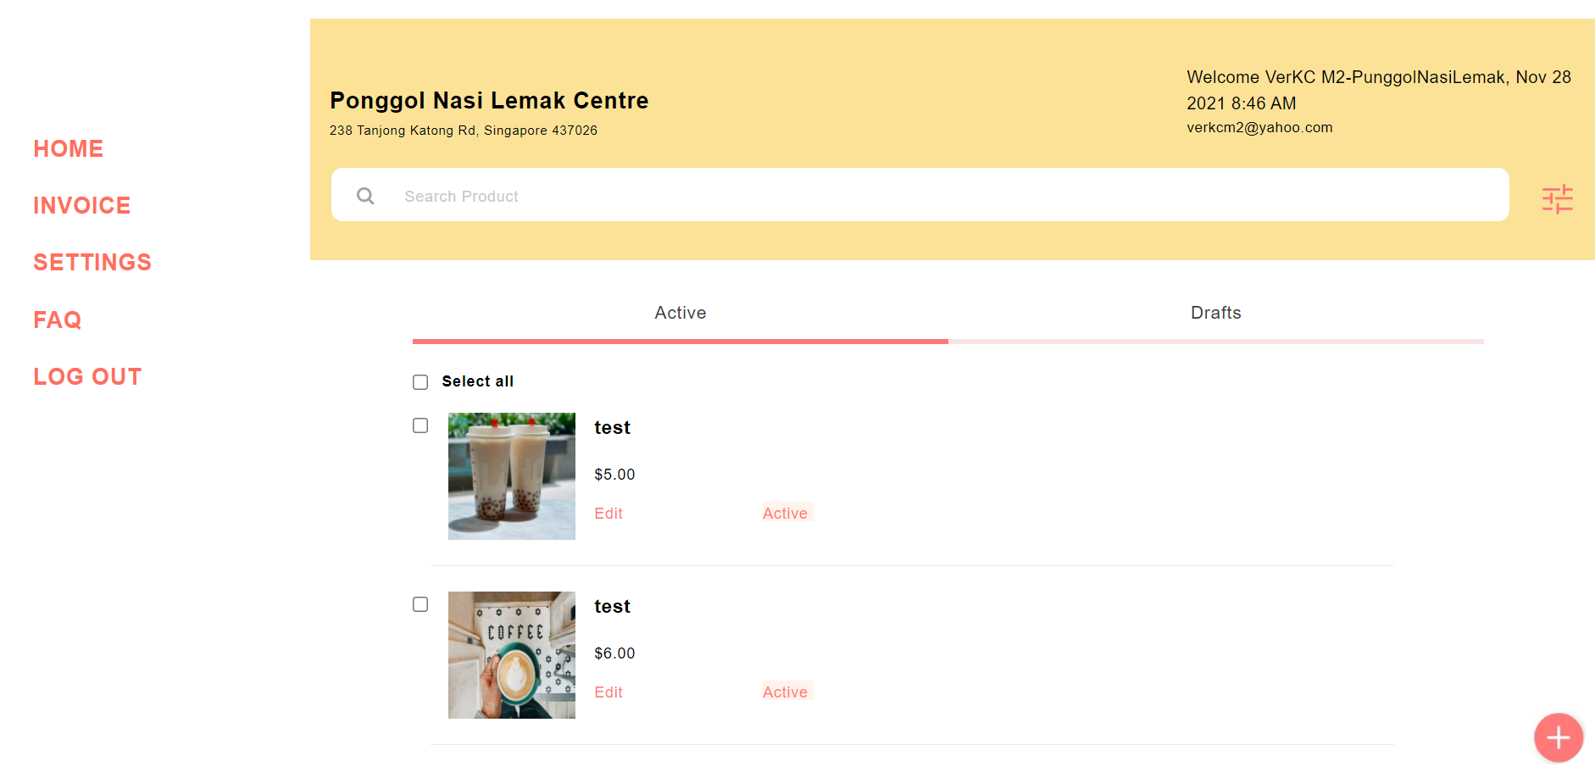
.mMainHeader (class name)
.m2sidenav (class name)
.email (class name)
MerchantProducts (line 1670)
#merchantContent (id name)
* Merchant invoice page have the same merchant content css, side nav css and header css

Slide 3
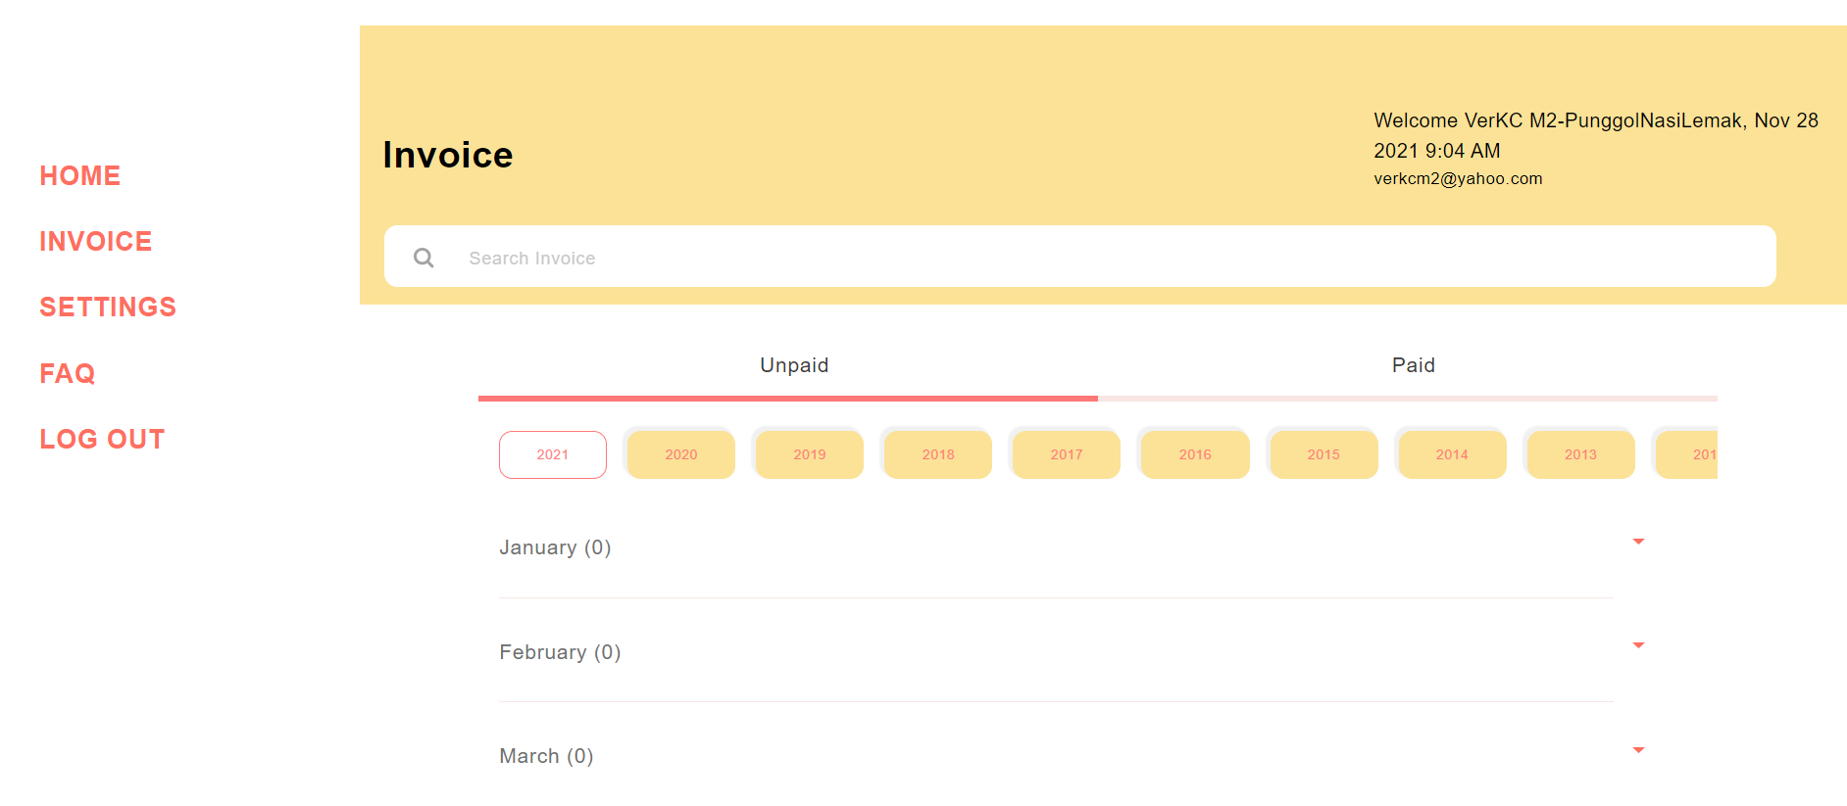
MerchantInvoice (line 2122)
* Merchant invoice page have the same merchant content css, side nav css and header css

Slide 4
KCTHEME SCSS (f5 to find the css to that page)
mHome -> MerchantProducts,
mProductEdit, mProductForm (add Product) -> MerchantProductFormInfo
minvoice -> MerchantInvoice
mCheckout -> MerchantCheckout
mOrderSummary -> MerchantOrderSummary
productPreview (add & edit) -> Merchant Product Preview
msettings -> Merchant Settings

Slide 5
Page size
@media screen and (max-width: 600px) -> mobile size
@media only screen and (min-width: 1111px) -> full screen and bigger
@media only screen and (min-width: 601px) and (max-width: 1110px) -> between mobile and full screen
* Css not under @media size applies for all page's size

